Slide 1

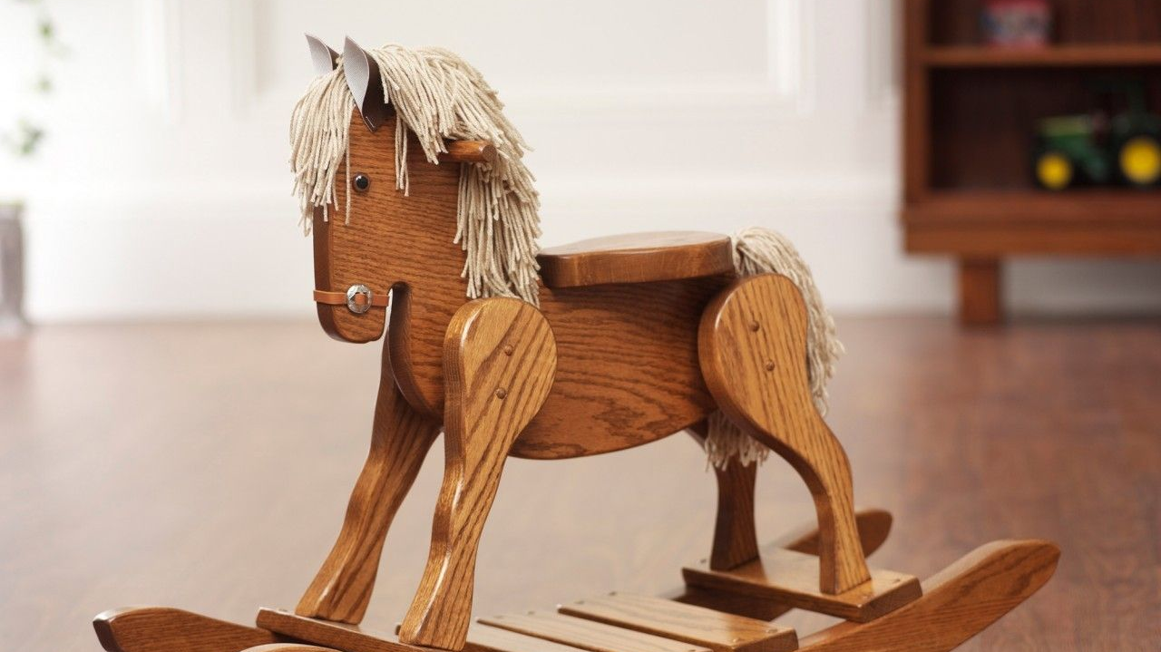
EarlyRiders Toy Horse Conjoint Study
MSMA Team G In-Person
Ying Zhu
Wensheng Cui
Huapeng Wang
Svarina Karwanyun

Slide 2

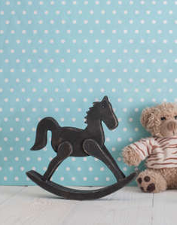
Highlights
Girls and Boys have different preferred size and style for toy horse
Girls prefer bigger size and boys are more price sensitive
3-4 years old prefer bigger toy horse
3 target groups

Slide 3
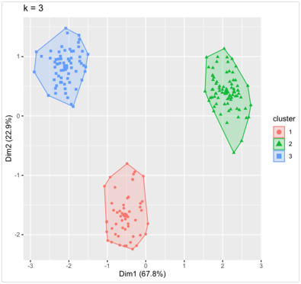
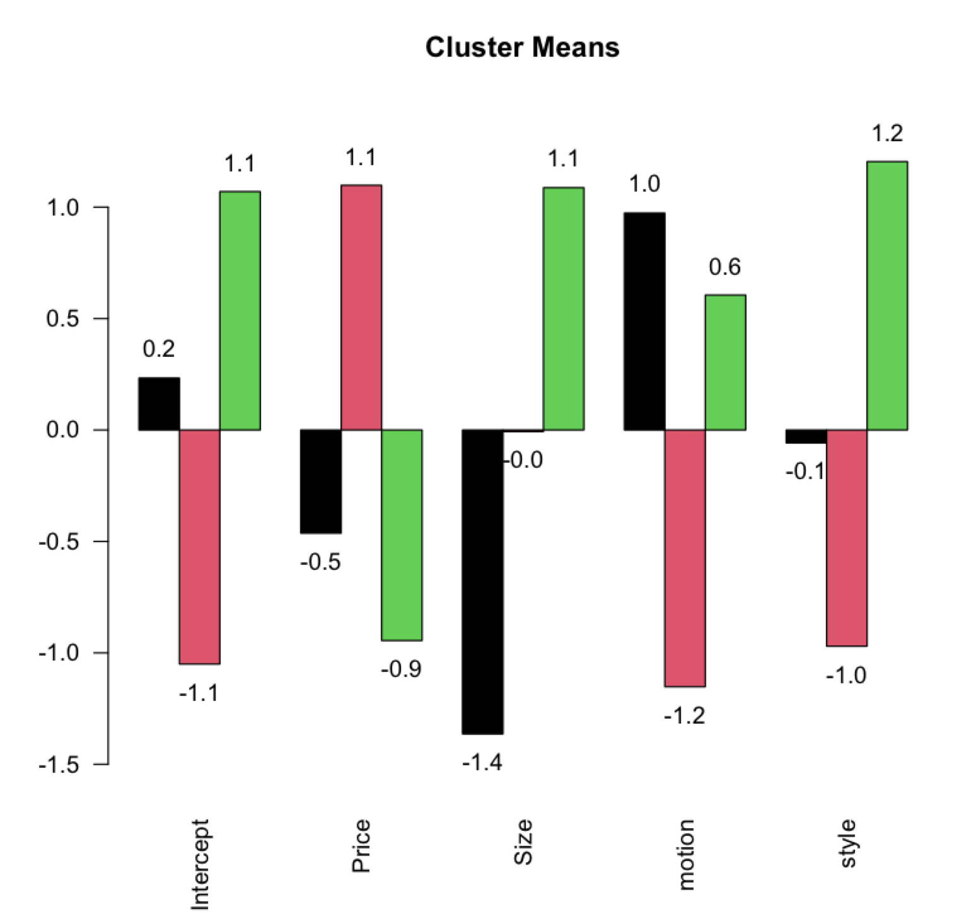
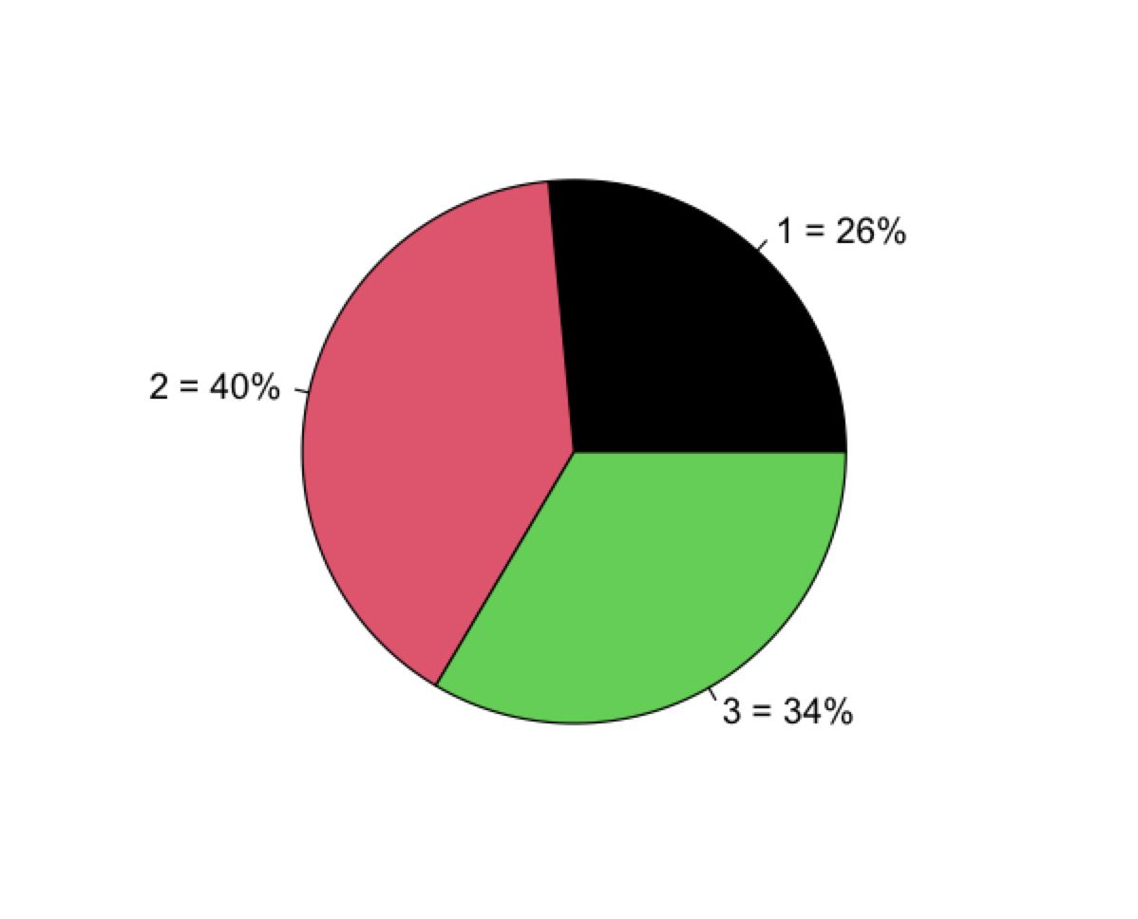
Post-hoc Segmentation
Girls:
Bigger size glamorous style
Rock motion
Girl
Boy
Boys:
Price sensitive
Bounce,
racing
Younger kids
Younger:
Smaller size,
Rocking
Care less about style
Notes:
Red = 40% boys
Green = 34% green
Black = 26% younger

Slide 4
A Priori Segmentation with Age and Gender
Segments | Intercept | Price | Size | Motion | Style
Boy, all age | 6.27 | 3.50 | 0.75 | -0.15 | -0.41
Girl, all age | 7.24 | 2.8 | 1.46 | 0.55 | 0.64
2-year-old, all gender | 6.96 | 2.96 | 0.71 | 0.52 | 0.18
3-4-year-old, all gender | 6.63 | 3.28 | 1.54 | -0.07 | 0.13
Price: $139.99=0 $119.99=1
Size: 18'' inch=0 26'' inch=1
Motion: Bouncing=0 Rocking=1
Style: Racing=0 Glamorous=1
1. All age and gender have high rate on $119.99 one
2. Girls prefer rocking motion and glamorous style, compared to boys
3. Girls and 3-4 years old kids prefer larger size, compared to boys and 2-year-old kids
Suggestions:
Manufacturing more numbers of toy horse of $119.99, 26'' inch height.
Placing rocking and glamorous toy horses in girl section in stores and placing bouncing and racing toy horses in boy section.

Slide 5
Market Simulation — product line strategy
Scenario A (Status quo) EarlyRiders P5,P13; RaceRiders: P7
Scenario B : add 26 inches rocking glamour P15
Scenario G: add 26 inches bouncing racing (P3) and 26 inches rocking glamour (P15) and cut P13, which does not perform very well in market
Scenario | P3 | P5 | P7 | P13 | P15 | Profits | Profit 5yr | Competitor 5Y
A |  | 30.0% | 57.5% | 12.5% |  | $ 141,883 | $ 709,415 | $ 1,038,385
B |  | 28.0% | 32.5% | 8.0% | 31.5% | $ 211,793 | $ 1,086,965 | $ 543,435
F |  | 34.5% | 33.0% |  | 32.5% | $ 229,333 | $ 1,174,666 | $ 553,334
G | 40.0% | 23.0% | 6.0% |  | 31.0% | $ 324,762 | $ 1,679,812 | $ 18,788

Slide 6
Market Simulation -- competitive response
Scenario H: If competitor reduce price from 139.99 to 119.99 (P8), earlyrider would lose advantage in the market
Scenario I: Respond to competition by reducing prices of the 3 product lines (P4,P6,P16) to regain market share, market share is 97.5% but the profit is lower than scenario G.
Scenario | P3 | P4 | P5 | P6 | P7 | P8 | P15 | P16 | Earlyrider Profits | Competitor profits
H | 0.5% |  | 6.5% |  |  | 86% | 7% |  | $ -16,245.6 | $ 251,725.6
I |  | 38% |  | 25% |  | 2.5% |  | 34.5% | $ 260,301 | $ -12,101

Slide 7
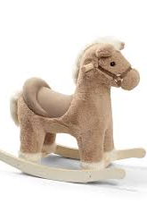
Recommendation
3 target groups: boys, girls and younger kids
Remove current 18'' glamorous rocking horse product line and change to 26'' glamorous rocking horse targeted to girls
Add 26'' bouncing racing horse targeted to boys
Existing 18'' racing rocking horse targeted to younger kids (2 years old)
Reduce price of products in response to competitor

Slide 8
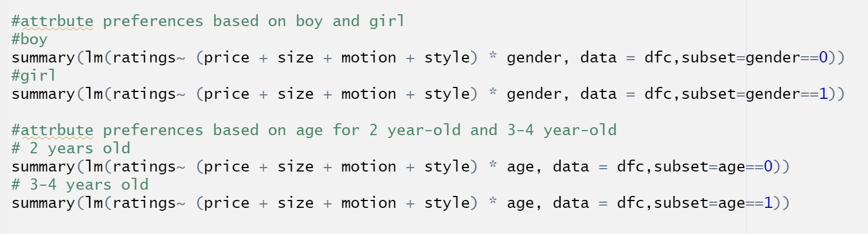
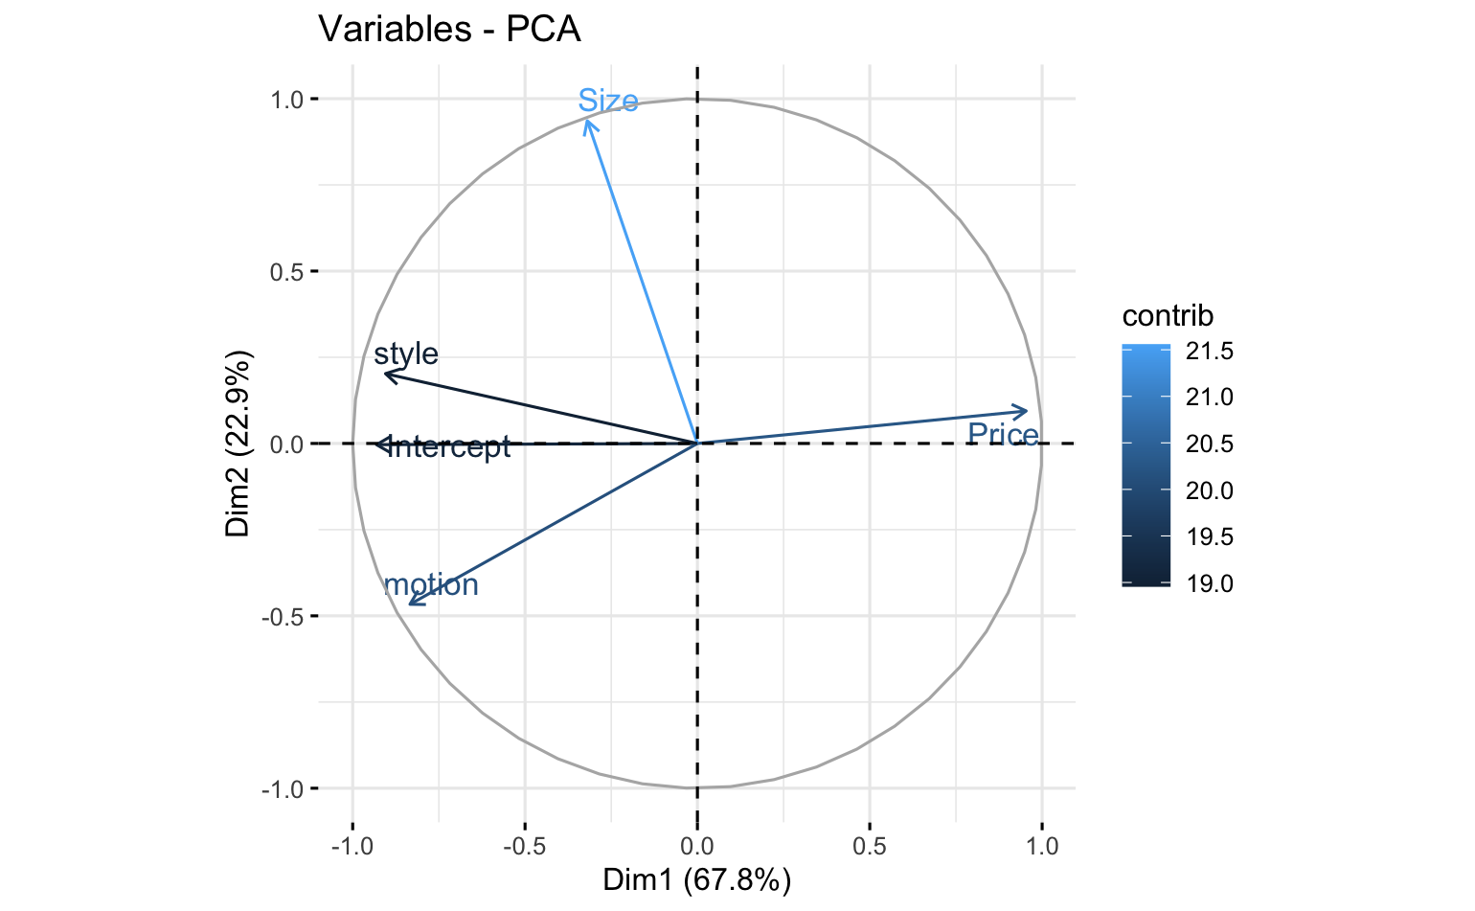
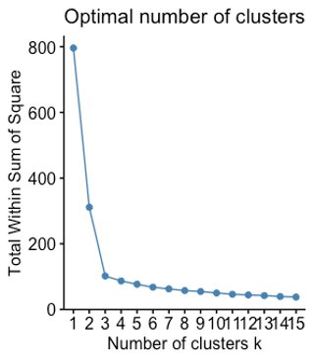
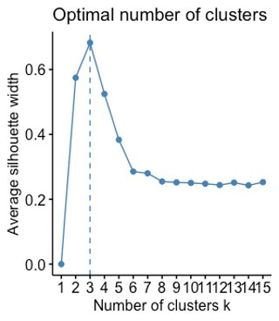
Appendix
a priori segmentation
PCA analysis: dim 1 price
Cluster analysis: 3 clusters is better than 2

Slide 9
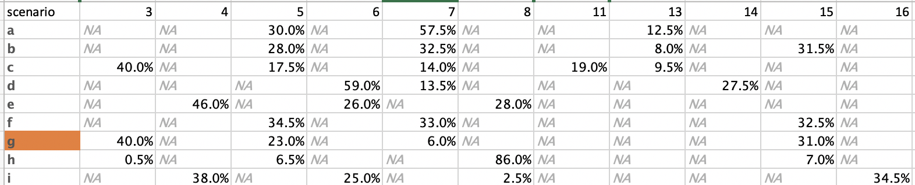
Appendix
Market simulations

